Slide 1
BOSTON we hear you
The Locomotive is here to save you ! Because We all need masks AND safety these days

Slide 2
General Analysis
Be aware of the data quality which can increase the number of incidents…
number of incidents in the database : 237 221
there are 11 337 duplicates
number of incidents after removing duplicates: 225 884
The analysis is conducted based on the database without duplicates

Slide 3
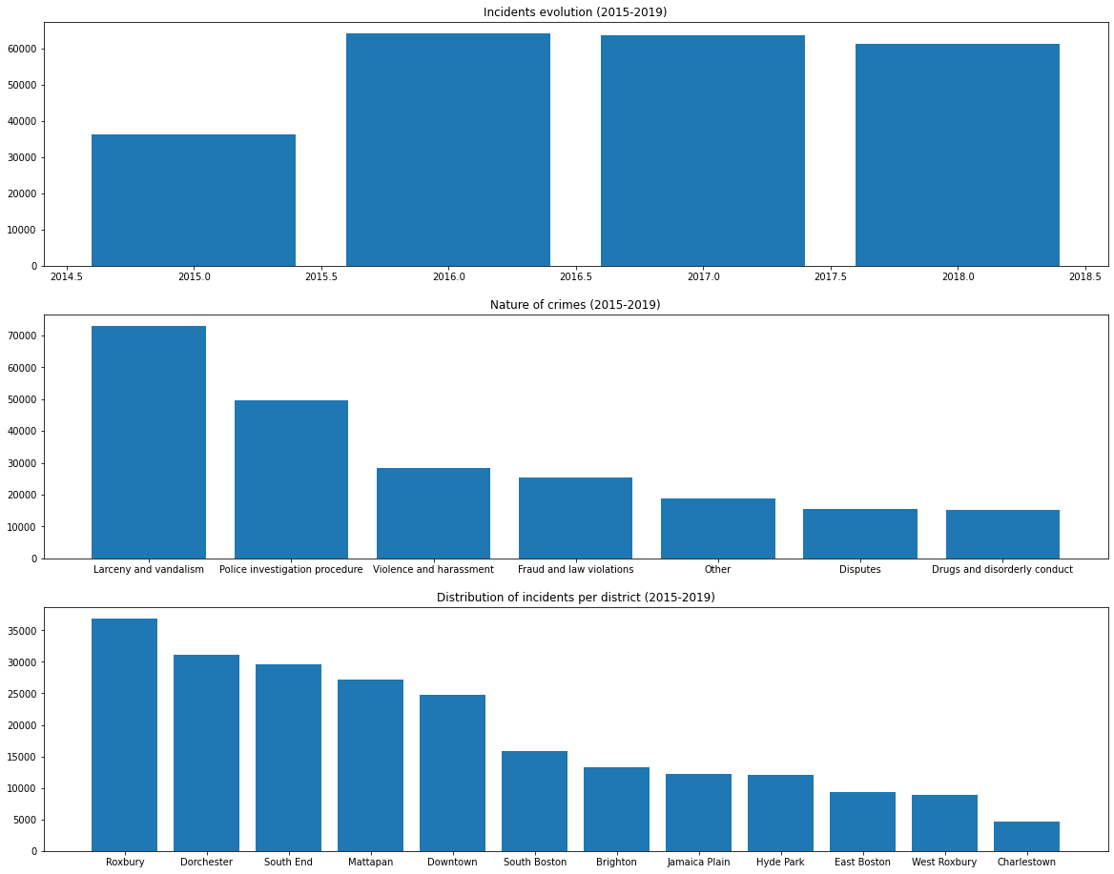
GLOBAL vIEW on incidents between 2015 - 2019
Over the 4 past years (2015-2019):
a significant increase between 2015 and 2016 (+76%) -> why ?
two main incident reasons are "Larceny and vandalism" and "Police investigation procedure" (54% of incidents)
55% of the incidents occured in 5 districts (out of 12)

Slide 4
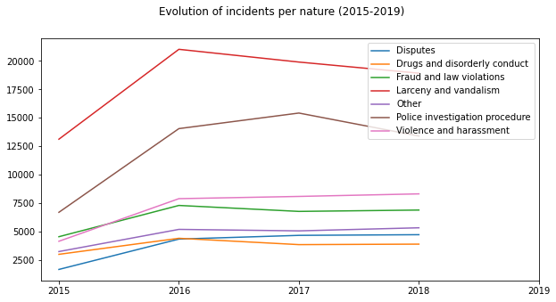
Evolution of incidents between 2015 - 2019
The high jump is due to "Larceny and vandalism", "Police investigation procedure" which are the two main incident reasons over the period.

Slide 5
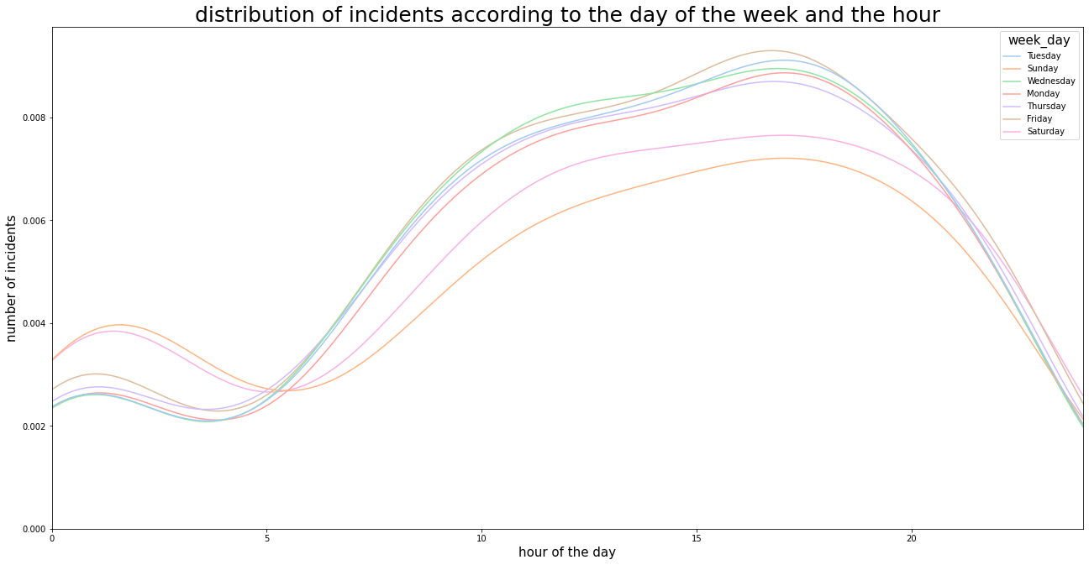
When do these two incidents occur ?
These two kind of incidents occur every day but especially on Friday in the afternoon -> Increase Police staff around these hours !

